Slide 1
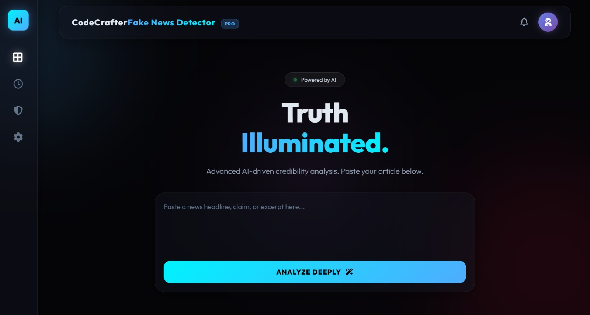
TRUTH ILLUMINT
Fake News Detection System
AI-powered credibility analysis with explainable insights
Team Name : Code crafters
Teammates : Makinur Rahman , Rupam Sur
Event : Axiora

Slide 2



The Problem
Exponential Spread
Verification Gap
Amplification Effect
Fake news travels faster than verified information, reaching millions before fact-checkers can respond
Average users lack tools to verify information quickly during breaking news events
Social media algorithms prioritise engagement over accuracy, multiplying misinformation
Critical Gap: Users need tools to understand WHY news is fake, not just a label

Slide 3
Our Solution
AI-Powered Analysis
Explainable Output
Confidence Metrics
Uses Google Gemini's large language model for deep reasoning and contextual understanding of news content
Provides detailed reasoning, not just binary labels. Users understand specific indicators of credibility
Shows probability scores and evidence-based assessments to guide user judgment
We don't just detect fake news - we explain it.

Slide 4
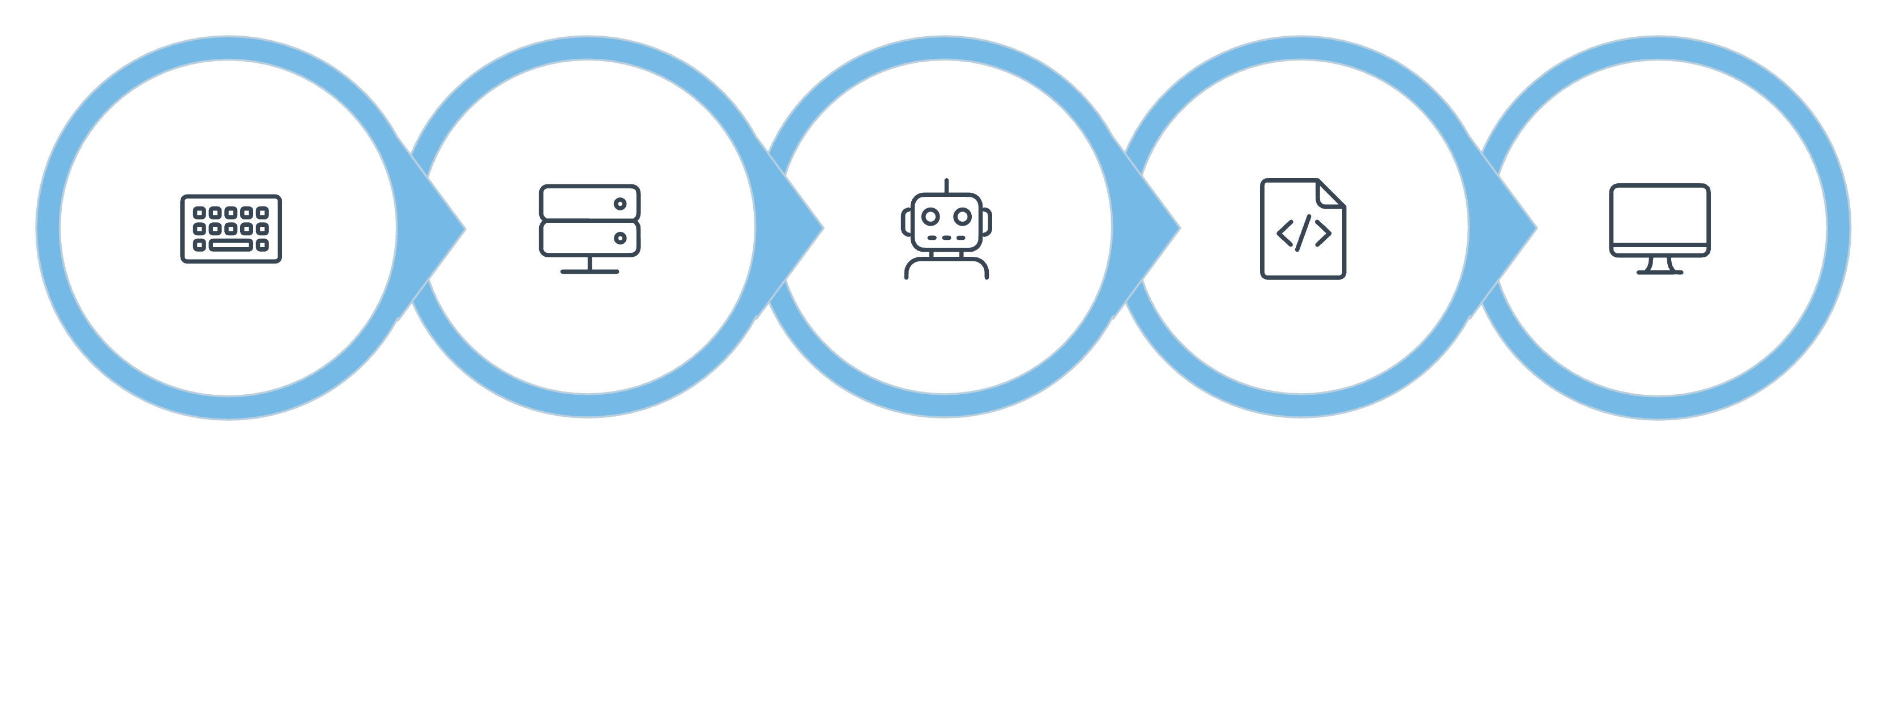
How TruthLens Works
Flask Backend
JSON Response
User Input
Gemini AI
Clean UI

Slide 5
Technology Stack
Frontend
Backend
HTML5 for structure
CSS3 for styling
JavaScript for interactivity
Python
Flask framework
Google.generativeAI
AI Engine
Security
Google Gemini API
LLM reasoning
Contextual analysis
dotenv for credentials
Input sanitisation
API rate limiting

Slide 6
Key Features
Binary Verdict
Clear Fake/Real classification with colour-coded indicators
Confidence Score
Percentage-based probability showing analysis certainty
AI Reasoning
Detailed explanation highlighting specific concerns and evidence
Bias Detection
Identifies potential slant, emotional language, or one-sided framing
Factual Summary
Concise fact-check overview with key verification points

Slide 7
User Interface
Design Philosophy
Real-Time Experience
Clean, intuitive interface prioritising clarity over complexity
Results display within seconds of submission
Minimalist colour scheme
Responsive layout
Accessible design
Fast loading times
Live confidence updates
Progress indicators
Error handling
Mobile-friendly

Slide 8
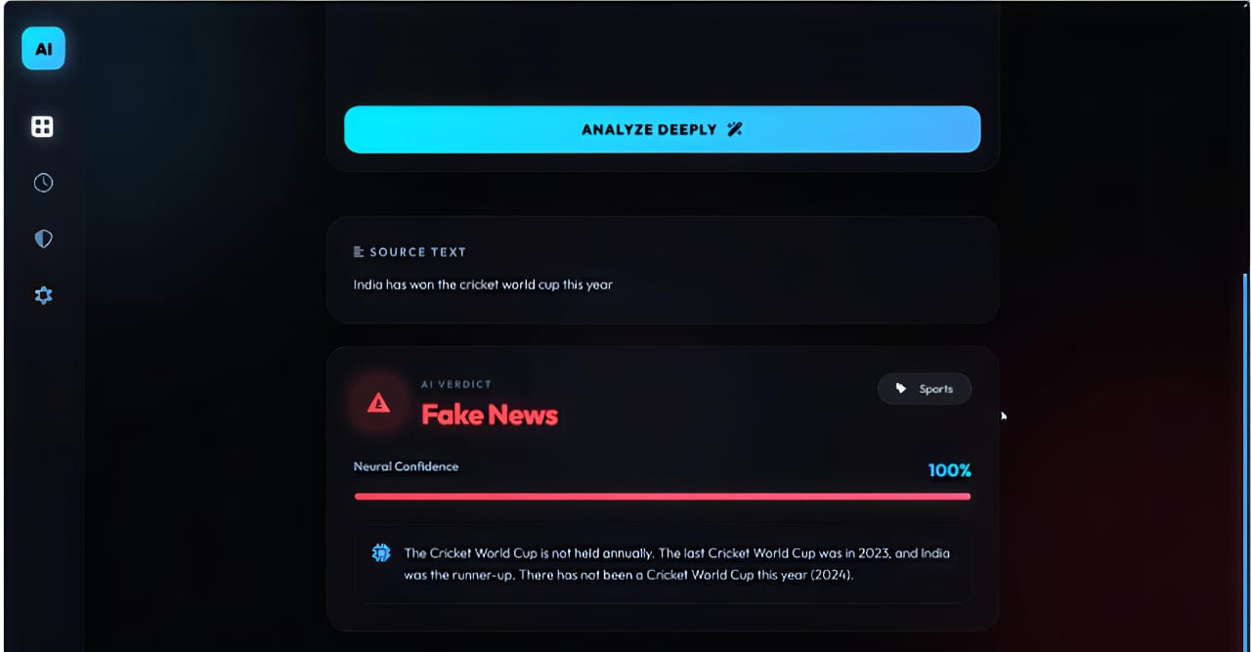

Live Demo Output
Sample Input
“India has won the cricket world cup match this year”
Verdict: Fake News
Key Indicators
Evidence Summary
Neutral Confidence
No credible sources cited
Conspiracy theory pattern
Contradicts established science
The Cricket World cup is not held annually. The last Cricket World Cup was in 2023, and India was the runner up ……….
System provides detailed reasoning about source credibility, logical fallacies, and factual inconsistencies

Slide 9
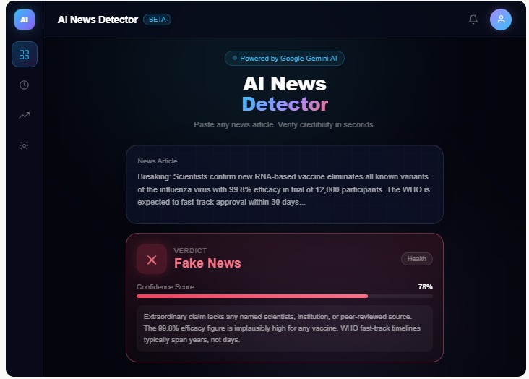
Limitations & Future Vision
Current Constraints
Future Enhancements
Accuracy Boundaries
AI models have inherent error rates and may produce false positives/negatives
Real-Time APIs
Integrate live fact-checking databases and news verification services
No Live Verification
Cannot access real-time databases or perform external fact-checking during analysis
Image Analysis
Input Quality
Verify manipulated images and deepfakes alongside text content
Results depend on text completeness and clarity provided by users
TruthLens is designed as an assistive tool, not absolute truth
Trends Dashboard
Track misinformation patterns across regions and topics
Multi-Language
Expand beyond English to detect fake news in regional languages

Slide 10



Impact & Closing
Empowers Users
Promotes Awareness
Equips individuals to identify misinformation before sharing
Builds critical thinking and digital literacy skills
Responsible Media
Supports informed media consumption and sharing
In a world full of noise, TruthLens brings clarity.
Thank you for your attention. We're ready to answer your questions.

